Slide 1
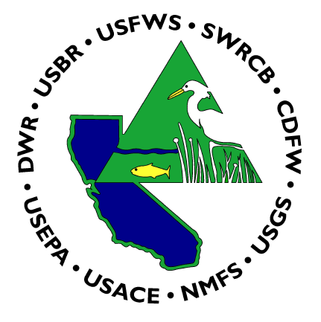
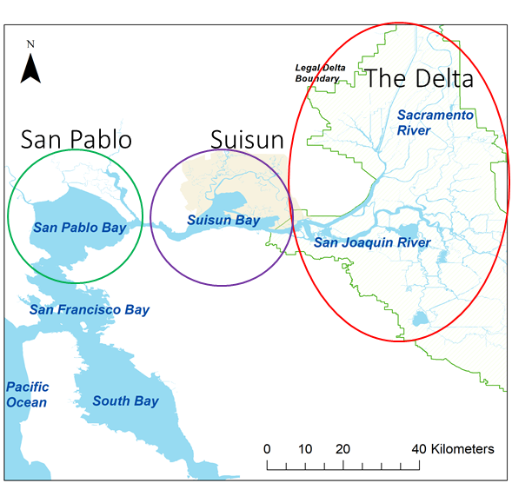
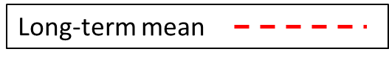
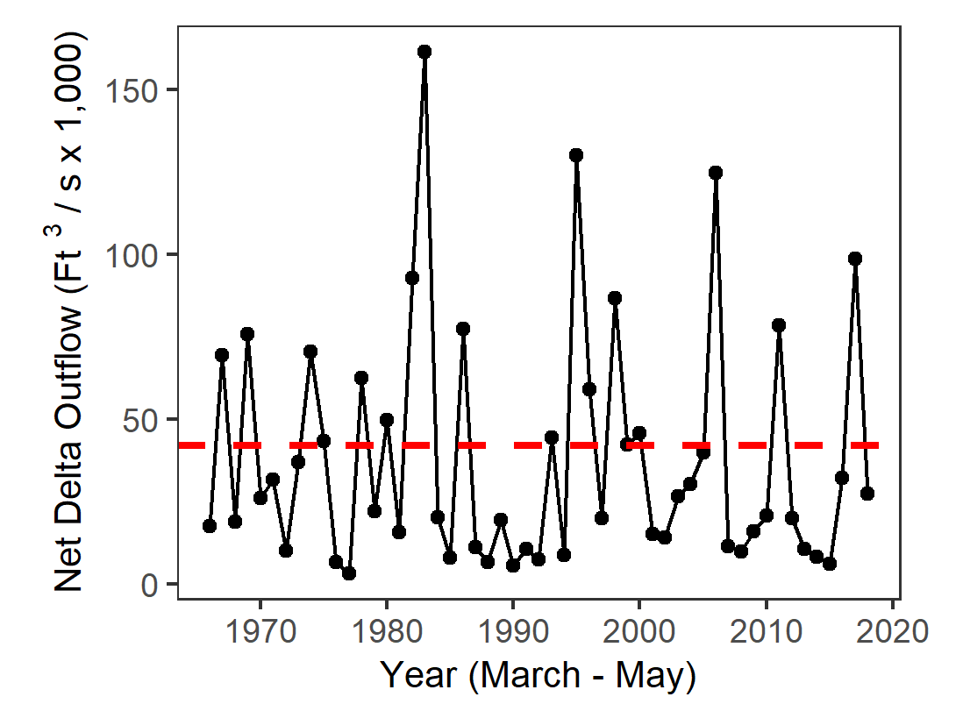
Spring 2018 IEP Seasonal Monitoring Report
Interagency Ecological Program for the San Francisco Estuary
This report shows trends in water quality, plankton, and fish across multiple IEP surveys for March, April, and May of 2018.
Contents
Secchi Depth……………..1
Temperature……………..2
Chlorophyll………………..3
Zooplankton………………4
Fish……………………………5
Fish (2004-2018)……….6
Metadata
Regions of the Estuary
Delta Outflow
Freshwater flow influences water quality, plankton, and fish populations.
Spring flow is driven primarily by rainfall, snowmelt, and upstream dam releases.
The spring of 2018 had slightly lower outflow than normal.
Disclaimer: While substantial efforts are made to ensure the accuracy of these data, complete accuracy of data sets cannot be guaranteed. This report was developed by the IEP Synthesis Team.
For questions, comments, or corrections, contact Rosemary Hartman – Rosemary.Hartman@water.ca.gov

Slide 2
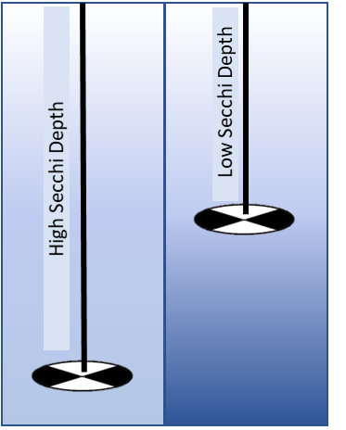
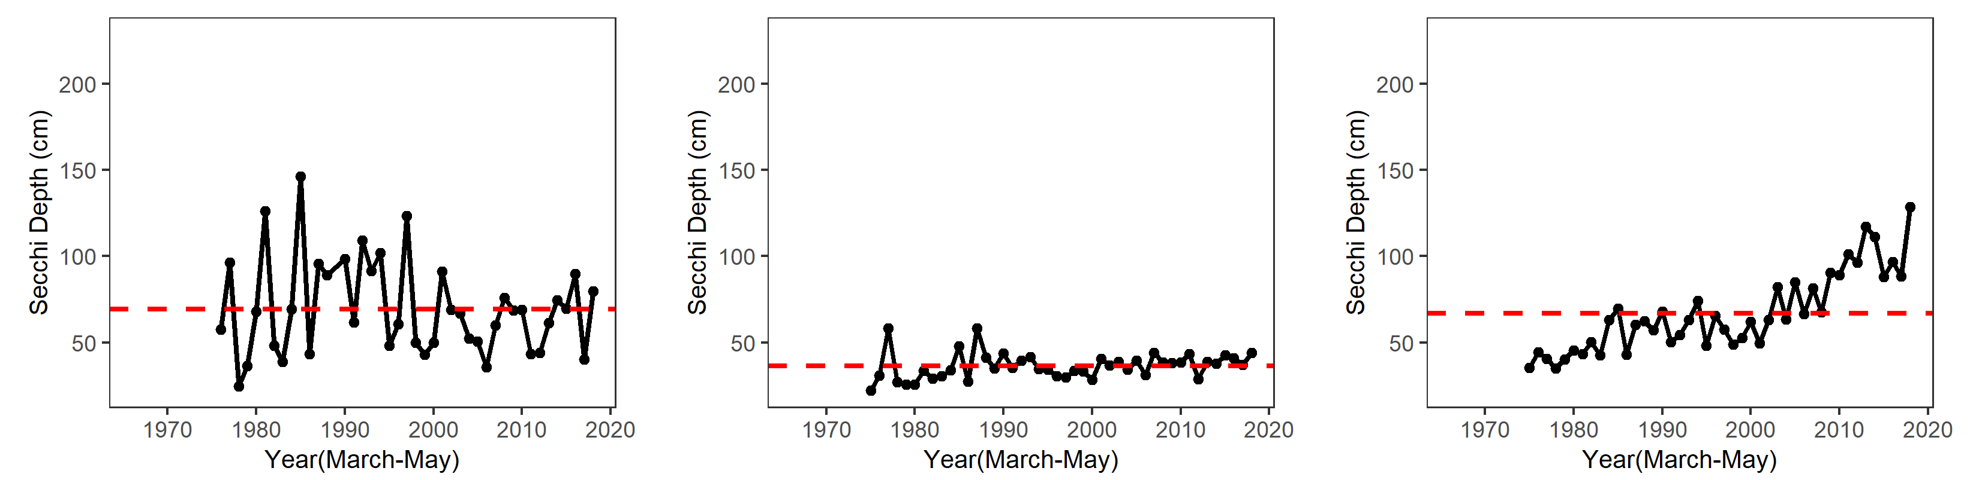
Secchi Depth
Interagency Ecological Program 2018 Spring Season Report
Secchi disk
Background
Organisms in this ecosystem are adapted to high turbidity conditions, and reductions in turbidity can have many negative ecological effects.
Higher values for Secchi depth indicate lower turbidity.
Secchi depth is measured monthly by DWR’s Environmental Monitoring Program by dropping a black-and-white disk in the water until it disappears.
For more information, see: Schoellhamer, D. H. 2011. Sudden clearing of estuarine waters upon crossing the threshold from transport to supply regulation of sediment transport as an erodible sediment pool is depleted: San Francisco Bay, 1999. Estuaries and Coasts 34(5):885-899.
San Pablo Bay
Suisun Bay
The Delta
In 2018, San Pablo bay was close to the long-term average.
In 2018, Suisun Bay was also close to the long-term average.
In 2018, the Delta was much clearer than average, the clearest Spring on record.

Slide 3

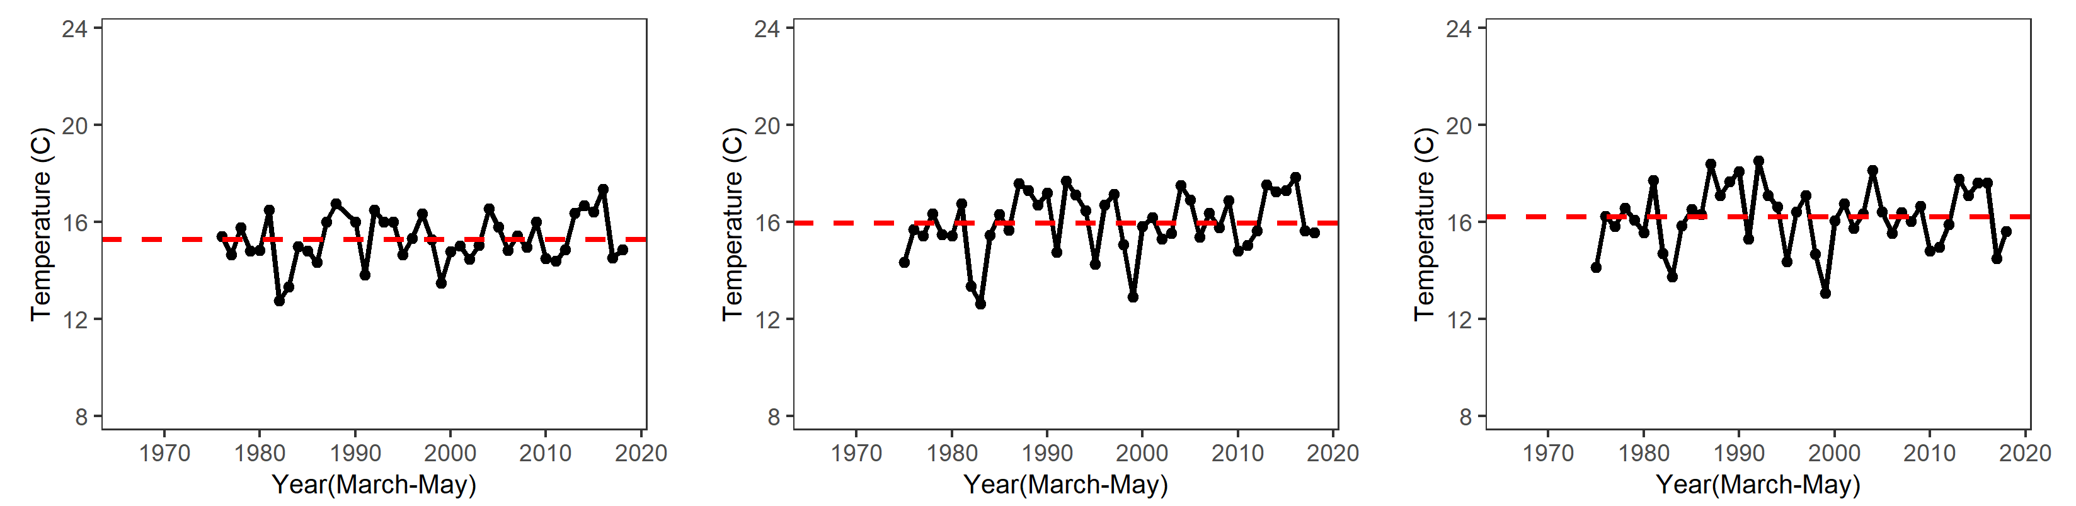
Water Temperature
Interagency Ecological Program 2018 Spring Season Report
Background
Water temperature is monitored monthly by DWR’s Environmental Monitoring Program
Fish growth and reproduction is highest in certain temperature ranges.
Increasing Spring temperatures may lower Delta Smelt reproduction.
Spring temperatures are lower closer to the ocean and slightly higher in the Delta.
For more information see: Jeffries, et al.. 2016. Effects of high temperatures on threatened estuarine fishes during periods of extreme drought. The Journal of Experimental Biology 219(11):1705-1716.
San Pablo Bay
Suisun Bay
The Delta
In 2018, San Pablo Bay temperatures were similar to the long-term average.
In 2018, Suisun Bay was similar to the long-term average.
In 2018, the Delta was slightly cooler than average.

Slide 4
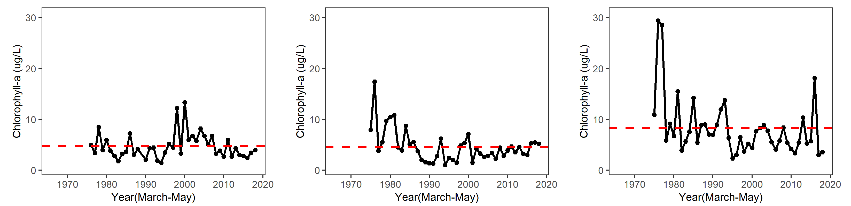
Chlorophyll
Interagency Ecological Program 2018 Spring Season Report
Background
Chlorophyll is an indicator of phytoplankton production, which is low during the Spring.
Phytoplankton are the base of the pelagic food web. It is sampled monthly by DWR’s Environmental Monitoring Program.
The invasion of the clam Potamocorbula amurensis caused a decline in phytoplankton and zooplankton after 1986 – especially in Suisun Bay.
For more information see: Cahoon, T. and T. Brown. 2018. Phytoplankton, Chlorophyll-a and Pheophytin-a Status and Trends 2017. IEP Newsletter 32(1):14-20.
Phytoplankton
San Pablo Bay
Suisun Bay
The Delta
In 2018, San Pablo Bay chlorophyll was about average.
In 2018, Suisun Bay chlorophyll was also about average.
In 2018, the Delta has slightly lower than average chlorophyll.

Slide 5
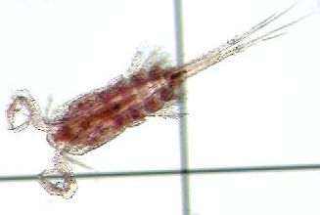
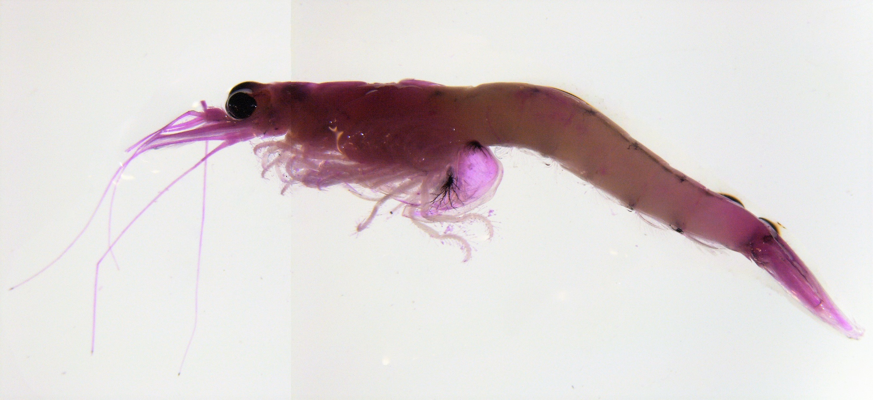
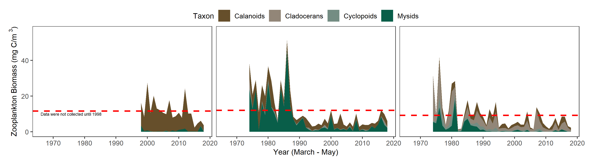
Zooplankton
Interagency Ecological Program 2018 Spring Season Report
Copepod
Background
Zooplankton is sampled monthly by the CDFW/DWR Environmental Monitoring Program, but sampling in San Pablo Bay did not begin until 1998.
Zooplankton are an important food source for pelagic fish.
Calanoid copepods and mysids are particularly good fish food. Cyclopoid copepods are not as good for fish food.
Biomass in Spring tends to be higher than Winter, but lower than Summer.
For more information see: Hennessy, A. 2018. Zooplankton Monitoring 2018. IEP Newsletter 32(1):21-32.
Mysid
San Pablo Bay
Suisun Bay
The Delta
In 2018, San Pablo Bay had much lower than average biomass, mostly calanoid copepods
In 2018, Suisun Bay also had much lower than average total biomass.
In 2018, the Delta also had much lower than average total biomass.
Notes:
Do we change the x axis so we can see it?
Also, Nick made these plots narrower and taller than the others.

Slide 6
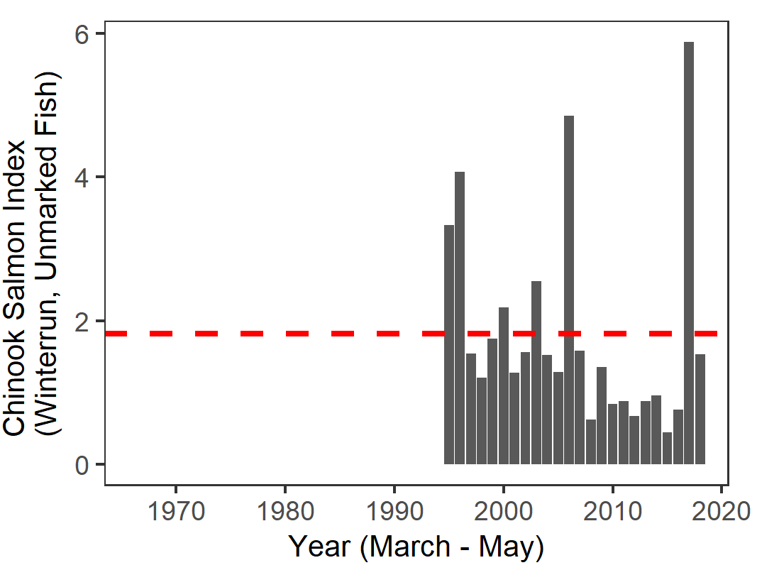
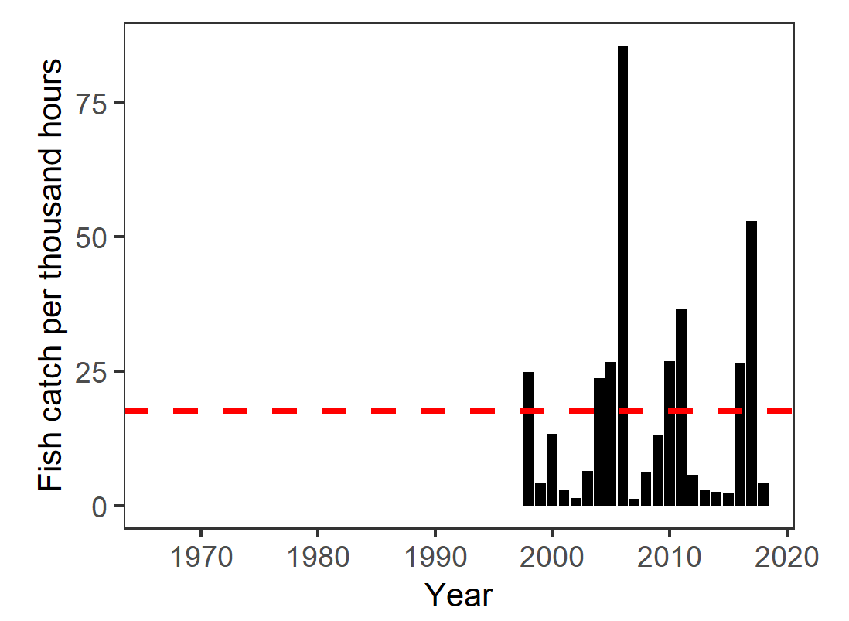
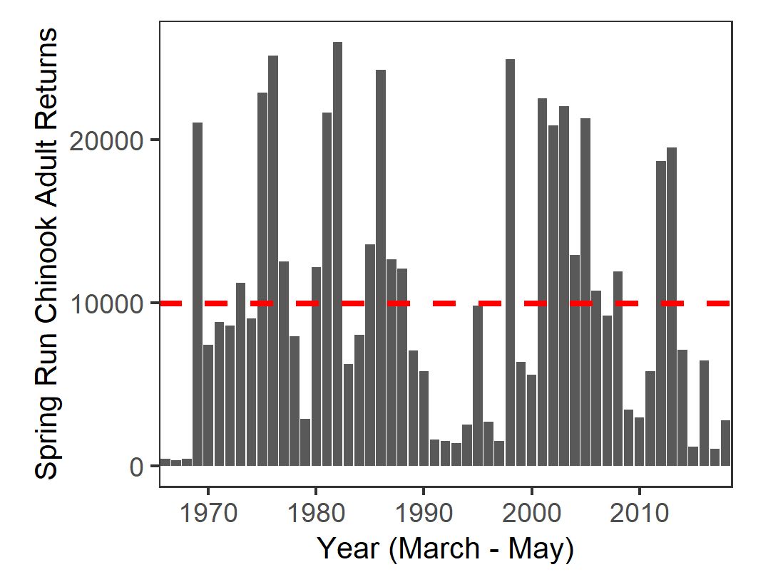
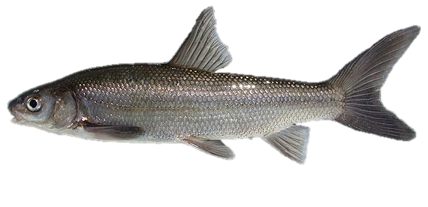
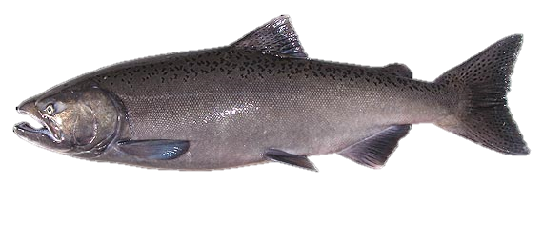
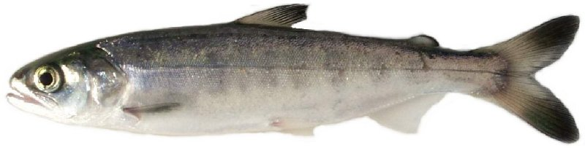
Fish
Interagency Ecological Program 2018 Spring Season Report
Background
Splittail are a native minnow that spawn on floodplains, so have high reproduction during high flow years when floodplains are inundated with water. They are sampled by DWR’s Yolo Bypass Monitoring Program.
Spring-run Adult salmon returns return from the ocean during the spring. Populations are calculated by CDFW based on redd counts, carcass surveys, fish entering hatcheries, and live fish counts.
Juvenile Winter-Run Chinook Salmon out-migrate to the ocean in spring, and are sampled by the USFWS’s Chipps Island Trawl, located at the confluence of the Sacramento and San Joaquin Rivers.
For more information, see: Kwan, N., J. Jenkins, C. Stuart, A. Shakya, and B. Schreier. 2019. 2011-2016 Yolo Bypass Fisheries Monitoring Status and Trends Report. IEP Newsletter 36(1):27-36.
Yolo Bypass Splittail
Spring-Run Chinook
Adult Returns
Juvenile Winter-Run Chinook (Chipps Island)
2018 was lower than the long-term average.
In 2018, adult Chinook returns were lower than average
In 2018, juvenile winter-run salmon survival was about average.

Slide 7
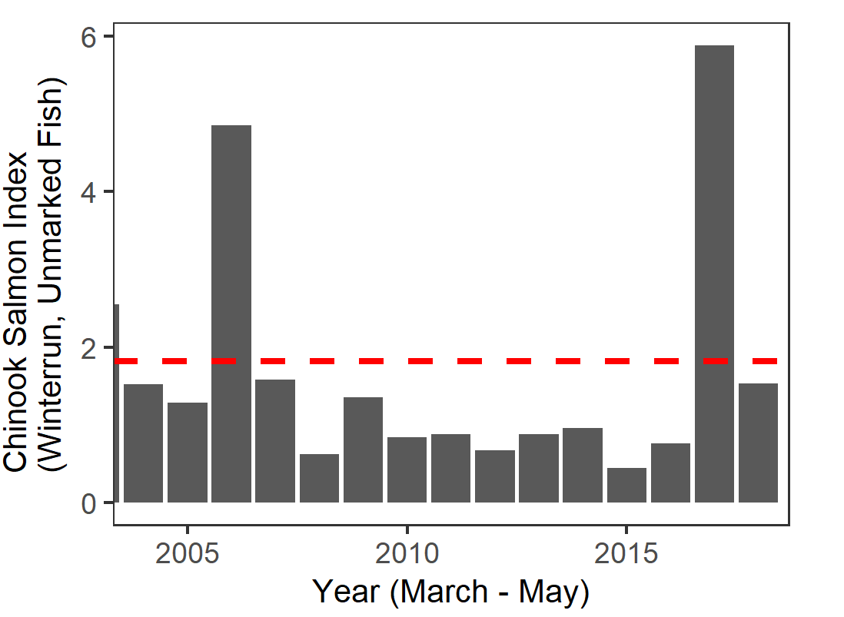
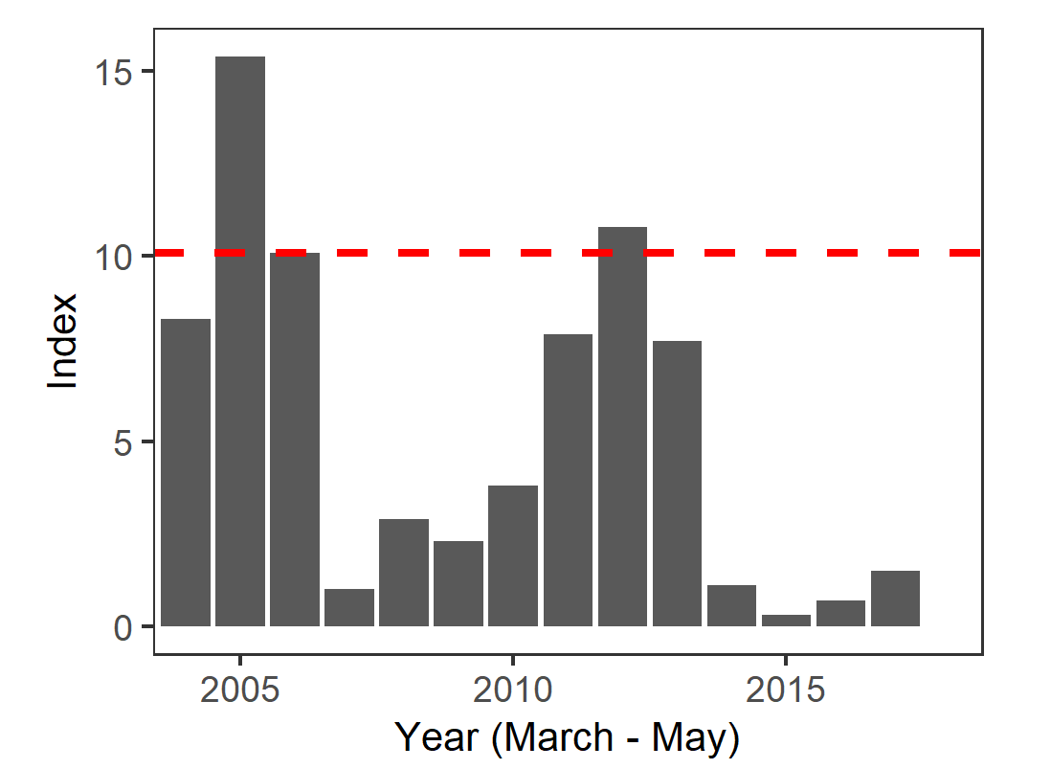
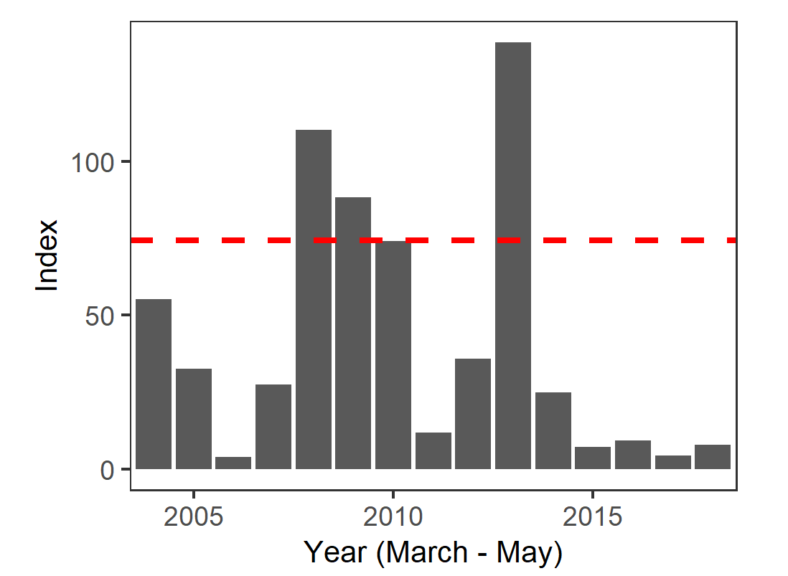
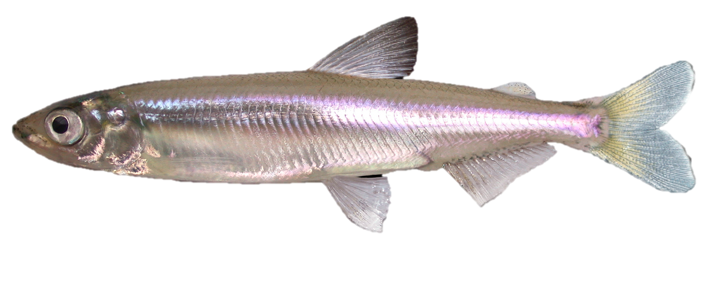
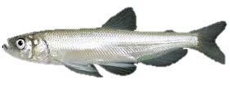
Fish: 2004-2018
Interagency Ecological Program 2018 Spring Season Report
Background
Delta Smelt and Longfin Smelt have been in decline since the early 2000s. The CDFW 20mm Survey was designed to sample post-larval and juvenile Delta Smelt, and samples in San Pablo, Suisun, and the Delta.
Longfin Smelt frequently spawn further downstream than Delta Smelt, so the 20 mm Survey does not cover their entire range, but still provides an indication of population-level trends.
Juvenile Chinook Salmon are sampled by the USFWS’s Chipps Island Trawl, located at the confluence of the Sacramento and San Joaquin Rivers.
For more information, see: Tempel, T. 2017. Evaluation of Adding Index Stations in Calculating the 20-mm Survey Delta Smelt Abundance Index. IEP Newsletter 30(1):21-23.
Delta Smelt
Longfin Smelt
Juvenile Winter-Run Chinook (Chipps Island)
The Delta Smelt 20mm index was zero in 2018, the lowest index on record.
Adult Longfin smelt abundance in 2018 was much lower than the long-term average.
In 2018, Juvenile winter-run Chinook had slightly lower survival than the long-term average, but better than many recent years.

